Slide 1
BIRDS-5
Weekly Update for Communication Subsystem and Antenna
Anechoic Chamber Test
26-Apr-2021
Ramson Nyamukondiwa
Edgar Mujuni
Iwase Tomoya

Slide 2
Test Carried Out
Test – 1 : Antenna tuning (Measuring the S11)
Calibration UHF (435-438 MHz)
Calibration VHF (144-146MHz)
Tuning of BIRDS-5 antenna
Determining S11 parameters
Test – 2 : Measuring Dipole Antenna Radiation Pattern
UHF and VHF antenna pattern in
E and H planes
Determine the antenna gain

Slide 3
Continue
Test – 3 : Measuring TRX Sensitivity with Dipole Antenna for 14Byte CMD
Calibration
Measure cable loses in Up and Downlink
Measuring the ICOM radio transmission power
Determine the path loss for Up and Downlink
Theoretical and Practical
Determine the gains with respect to the
Reference antenna, Commercial dipole antenna and Birds 5 antenna.
Measure received and transmitted signal power at the antenna
Uplink success rate

Slide 4
Test – 1 : Antenna tuning (Measuring the S11)
To measure S11 value with vector network analyzer is going to be used (calibrated)
Door-2
Satellite
Network Analyzer
Coaxial Cable
Anechoic chamber
Door-3
Door-1

Slide 5
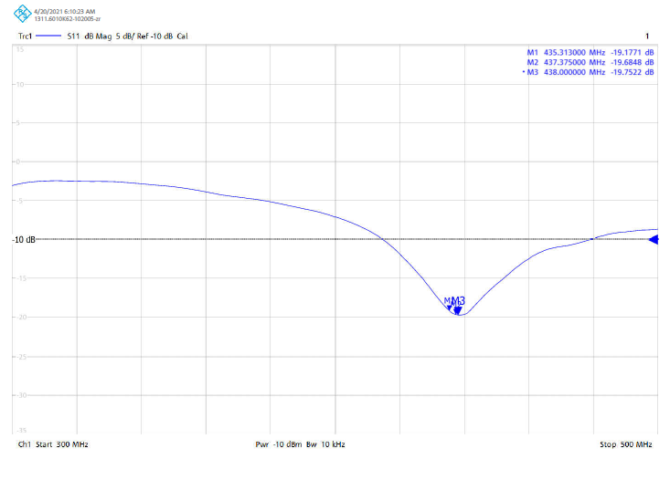
S11 Value for UHF Dipole Antenna
-20 dB

Slide 6
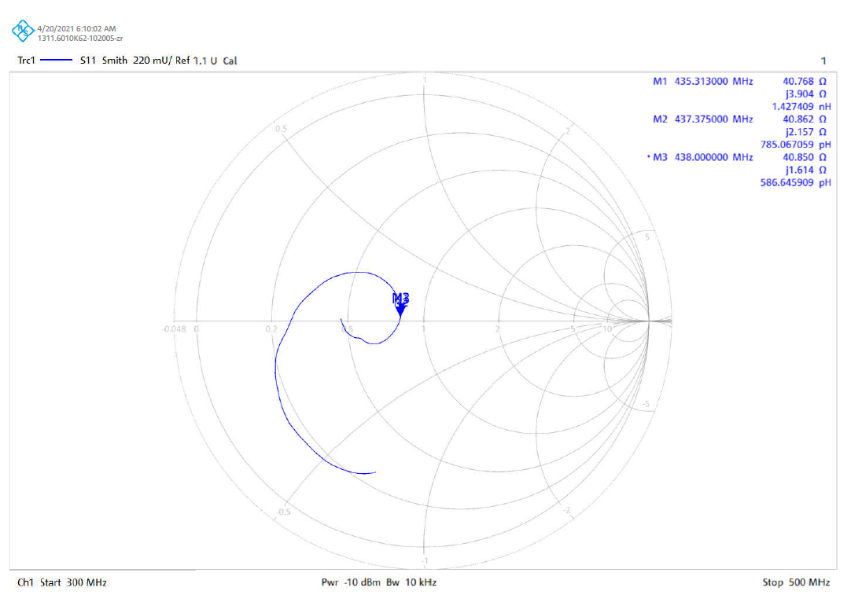
S11 Smith Chart UHF Dipole Antenna

Slide 7
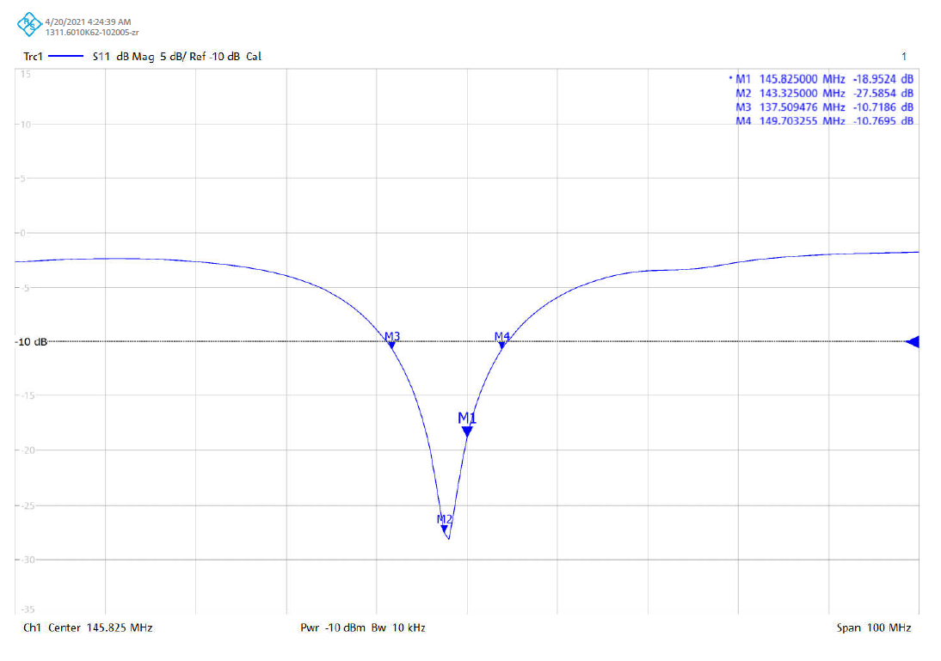
S11 Value for VHF Dipole Antenna

Slide 8
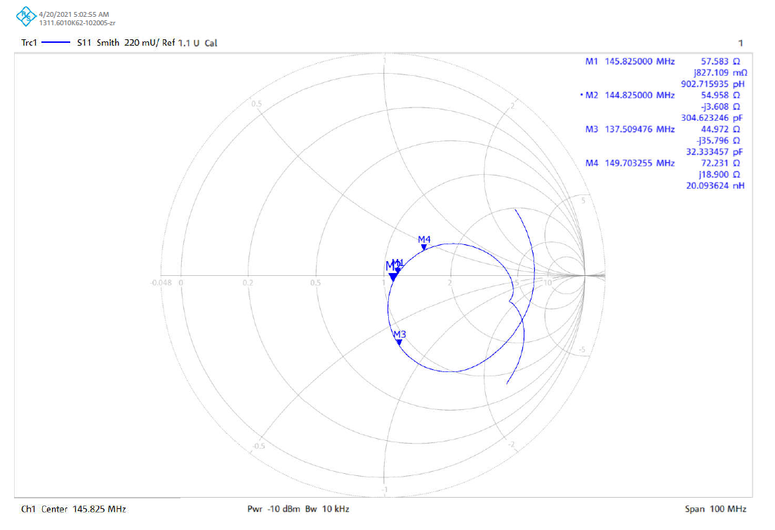
S11 Smith Chart VHF Dipole Antenna

Slide 9
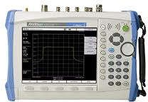
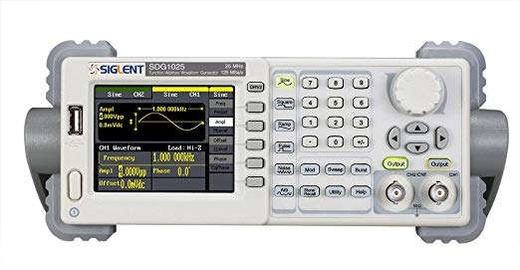
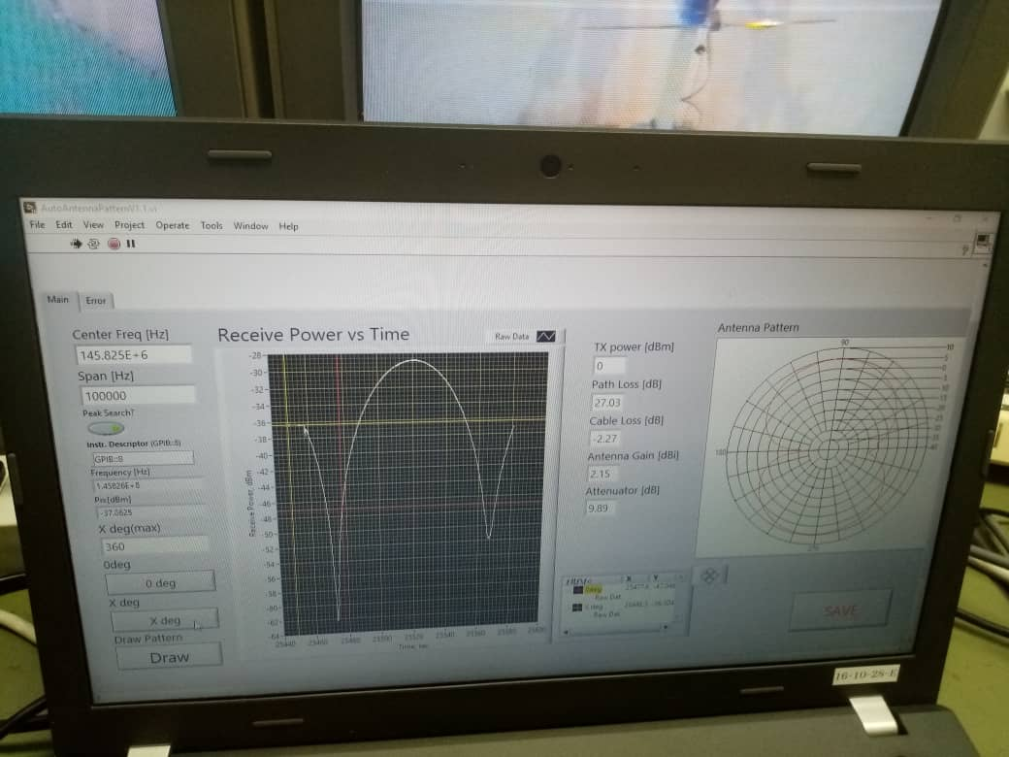
Test-2:Measuring Dipole Antenna Radiation Pattern
Test setup
G1
Reference Antenna
Ptx
P_{rs}
Satellite
Lpath =3.6m
G
L1=3.0 dB
Spectrum analyzer
L2=0.3 dB
Prx
P_{ts}
Signal Generator
In decibel scale
P_{rs} = P_{ts} − L₁ − L₂ − L_{path} + G₁ + G
PC

Slide 10
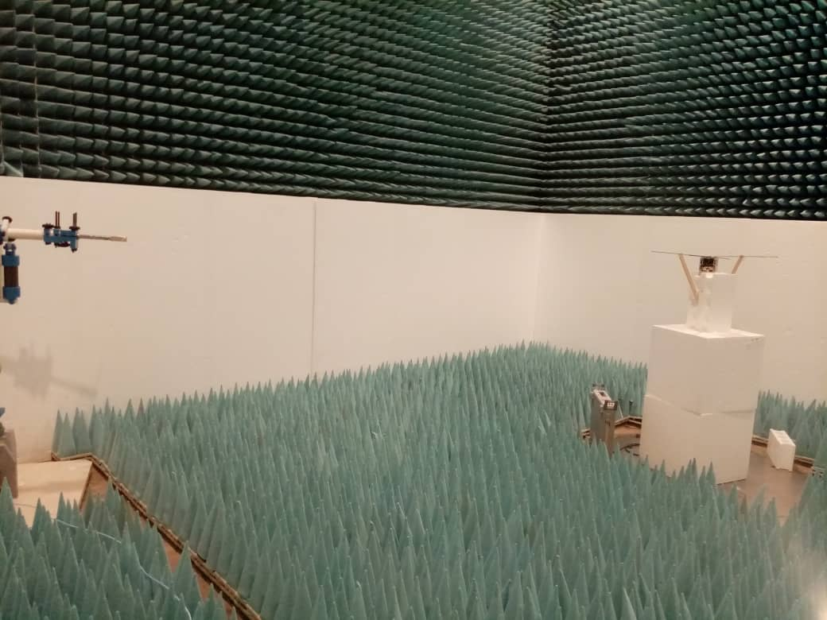
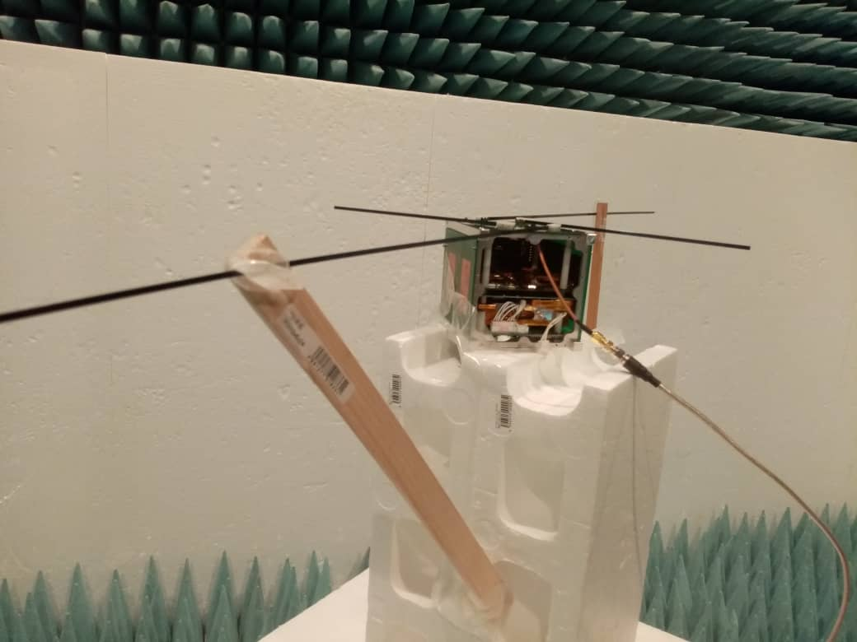
UHF Dipole Antenna: E Plane
In this case, reference antenna and satellite antenna are in horizontal orientation and turn table is rotated to get E-plane radiation pattern
Satellite antenna
Reference antenna

Slide 11
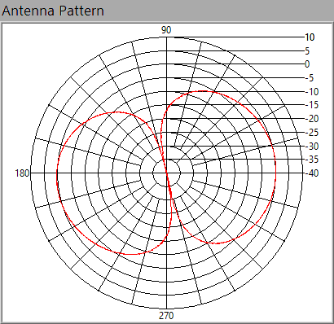
UHF Dipole Antenna: E Plane

Slide 12
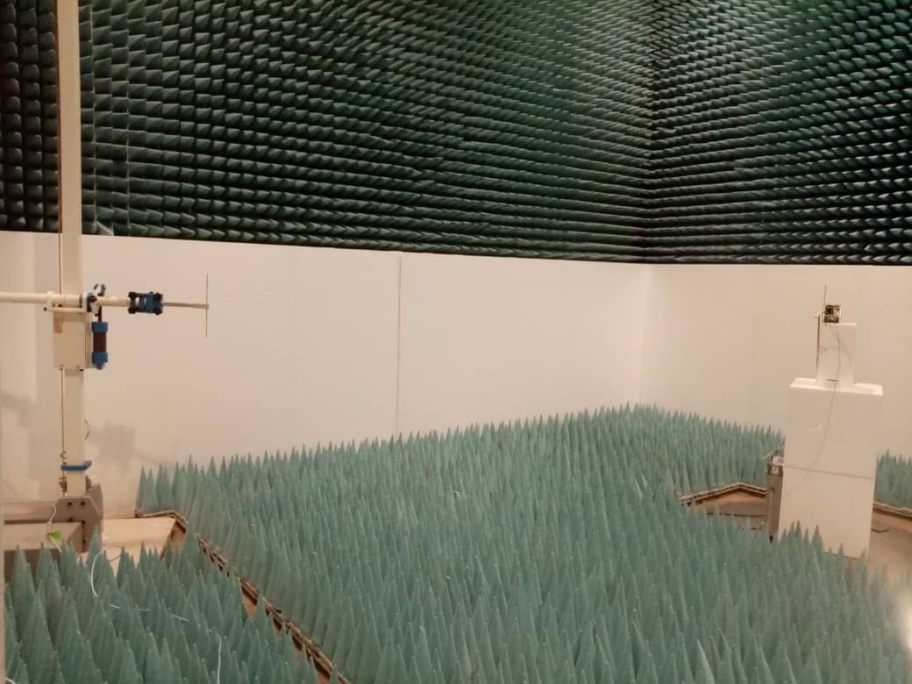
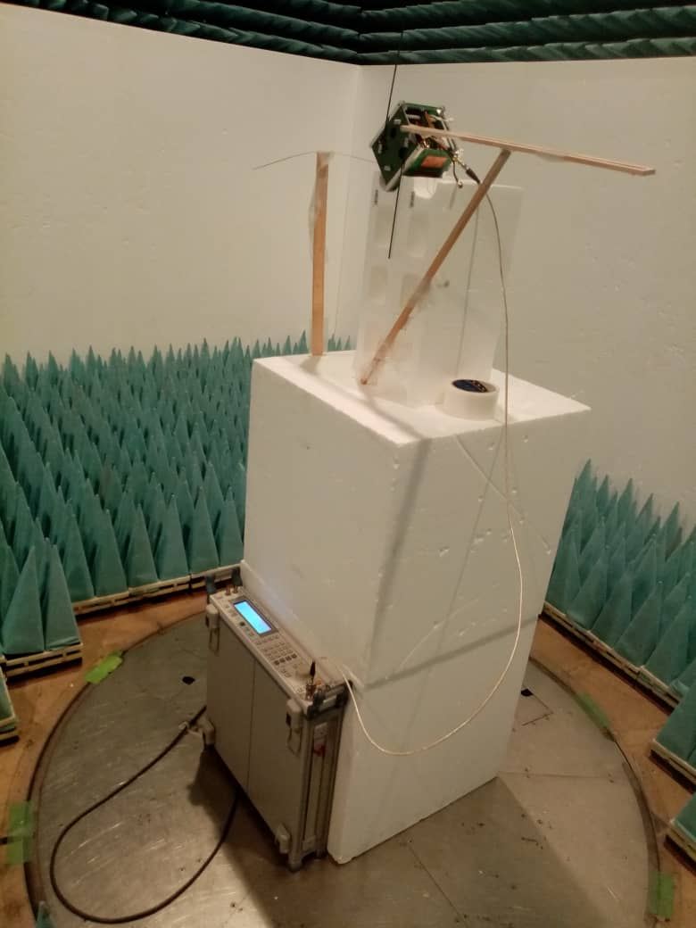
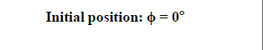
UHF Dipole Antenna: H Plane
In this case, reference antenna and satellite antenna are in vertical orientation and turn table is rotated to get H-plane radiation pattern
Satellite antenna
Reference antenna

Slide 13
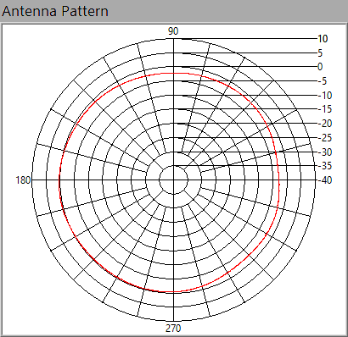
UHF Dipole Antenna: H Plane

Slide 14
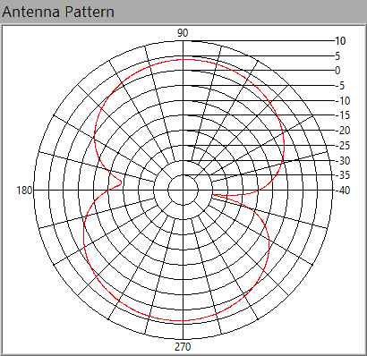
VHF Dipole Antenna: E Plane

Slide 15
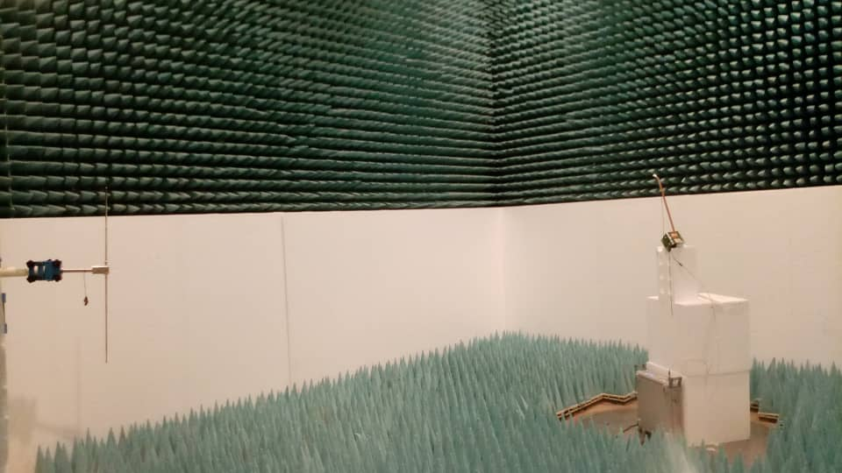
VHF Dipole Antenna: H Plane: Setup

Slide 16
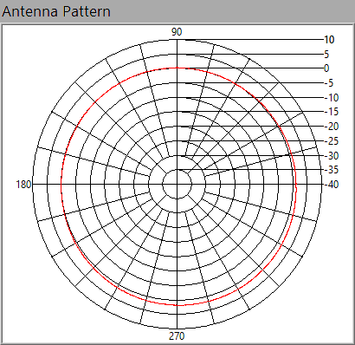
VHF Dipole Antenna: H Plane

Slide 17
Test 3: Measuring UHF TRX Sensitivity (14 byte CMD)

Slide 18


Test 4: Measuring UHF TRX Sensitivity (14 byte CMD)
Test Setup
UHF Dipole antenna
47dBm
ICOM-9100 Radio
Variable Attenuator
Satellite
40dBm
TNC

Slide 19

Measuring UHF TRX Sensitivity
Ground station Location
Reference antenna
GS
Door-2
Satellite
Anechoic chamber
Door-1
Door-3

Slide 20
Calibration Uplink (435.313 MHz)
Radio Transmission Output
Cable Losses
Radio
SA
Att
47dBm
40dBm
6.8dBm
SG (0dBm)
SA
Ptx-Lc –attenuation =Prx (SA)
Big cable loss: Lc=3.0dB
Small cable loss: Lc =0.3

Slide 21
Uplink
Path Loss
Theoretical: Lpath= 20log (4*pi*D*f /c )
where pi=3.14.., D= 3.56m, f=435.313 MHz, c= 3*10^8 m/s^2
Lpath= 36.25 dBm
Practical
Ref Antenna
G=2.2 dBi
Int.Att=9.9 dB
Ref Antenna
G=2.2 dBi
Int.Att=9.9 dB
D
Radio+Atte
OR
SG (0dB)
SA
Lpath
L1=3.0 dB
L2=0.3 dB
Lpath=37 dBm

Slide 22
Testing the Antenna Gain in Uplink
Rx Antenna | Prx (dBm) | Antenna Gain
Ref Dipole Antenna with 9.9 dB attenuation | -55.7dBm | 2.2 dBi
Commercial Dipole Antenna | -47.4 dBm | 0.6 dBi
BIRDS 5 Dipole Antenna | -47.6 dBm | 0.4 dBi
Measured and verified with SG setup as well as Radio setup
SA: Noise floor= -112 dBm

Slide 23
Received Power Measurements in Uplink (Setup Calibration)
Variable Attenuation(dB) | Effective Att (dB) | Expected Prx using SAT Antenna | Measured Prx using Sat Antenna
40 | 87.6 | -40.6 | -40.6
90 | 137.6 | -90.6 | -90.7
93 | 140.6 | -93.6 | -93.3
96 | 143.6 | --96.6 | -96.7
99 | 146.6 | -99.6 | -99.4
102 | 149.6 | -102.6 | -102.2
105 | 152.6 | -105.6 | -105.1
108 | 155.6 | -108.6 | -107.4
109 | X | X | X
111 | X | X | X
114 | X | X | X

Slide 24
Sensitive Testing
Variable Attenuation(dB) | Total Att excluding Sat Antenna | Expected Prx using SAT Antenna | Packet Success Rate (ftx=435.313 MHz)
90 | 138 | -90.6 | 6/6
92 | 140 | -92.6 | 6/6
94 | 142 | -94.6 | 6/6
96 | 144 | -96.6 | 4/6
97 | 145 | -97.6 | 3/6
98 | 146 | -98.6 | 3/6
99 | 147 | -99.6 | 1/6
100 | 148 | X | X
Reason for low sensitivity: Downlink gain not good

Slide 25
Downlink Sensitivity( 437.375)
Cable Losses
Same with uplink
Path Loss (Lpath)
Theoretical: Lpath= 20log (4*pi*D*f /c )
where pi=3.14.., D= 3.51m, f=437.375 MHz, c= 3*10^8 m/s^2
Lpath= 36.16 dBm
Practical
Ref Antenna
G=2.2 dBi
Int.Att=9.9 dB
Ref Antenna
G=2.2 dBi
Int.Att=9.9 dB
D
Radio+Atte
OR
SG (7dB)
SA
Lpath=34.9 dBm

Slide 26
Testing the Antenna Gain in Downlink
Rx Antenna | Prx (dBm) | Antenna Gain
Ref Dipole Antenna with 9.9 dB attenuation | -46.6dBm | 2.2 dBi
Commercial Dipole Antenna | -38.5 dBm | 0.4 dBi
BIRDS 5 Dipole Antenna | -24.8 dBm | 0.8 dBi
****BIRDS 5 Dipole Antenna : Antenna + SG, Ant. G= 0.3 dBi
Measured and verified with SG setup as well as Radio setup
SA: Noise floor= -112 dBm

Slide 27
Next Task
Use Oscilloscope to measure the transmitted and received waveform
Use Simulation tool CST to do the antenna radiation pattern
Determine packet errors
New design for the antenna
Burner circuit implementation

